Slide 1

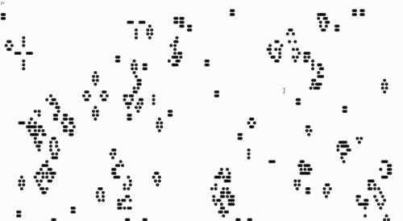
Parallel Computing 2019-2020
Parallelization of Game of Life
using Message Passing Interface (MPI)
A tribute to John Horton Conway
Presented and prepared by Nicu Ghidirimschi

Slide 2



John Horton Conway
English mathematician active in the theory of finite groups, knot theory, number theory, combinatorial game theory and coding theory.
On 11 April 2020, at age 82, he died of complications from COVID-19.
Notes:
Born and raised in Liverpool, Conway spent the first half of his career at the University of Cambridge before moving to the United States, where he held the John von Neumann Professorship at Princeton University for the rest of his career.

Slide 3
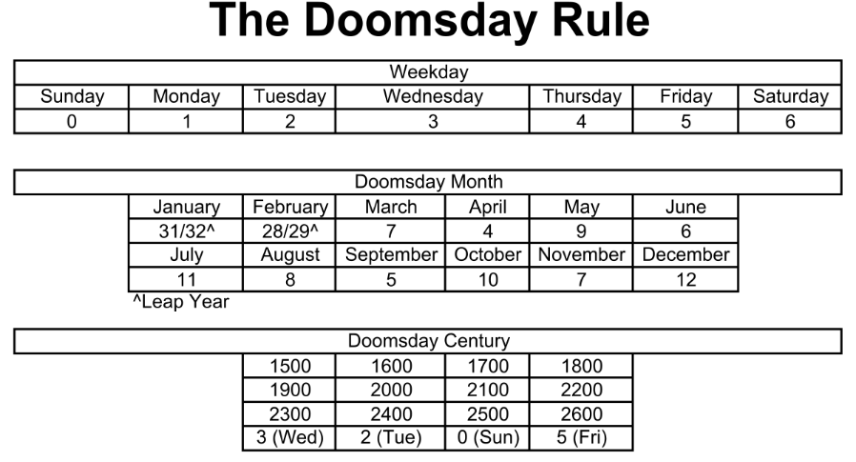
John Horton Conway
An algorithm of determination of the day of the week for a given date. It is simple enough that it can be computed mentally. Conway could usually give the correct answer in under two seconds. ^{[1]}
[1] https://en.wikipedia.org/wiki/Doomsday_rule

Slide 4
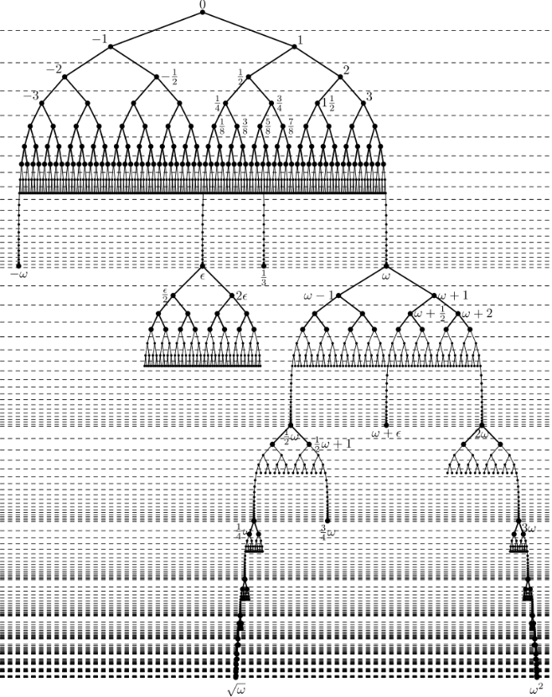
John Horton Conway
Surreal numbers ^{[2]}
[2] https://en.wikipedia.org/wiki/Surreal_number

Slide 5
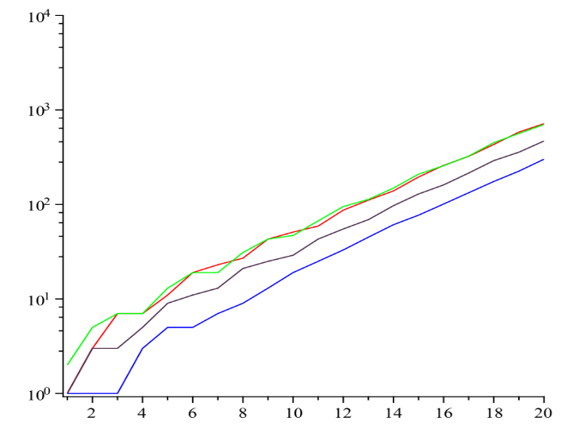
John Horton Conway
Look-and-say sequence
To generate a member of the sequence from the previous member, read off the digits of the previous member, counting the number of digits in groups of the same digit. For example:
1 is read off as "one 1" or 11.
11 is read off as "two 1s" or 21.
21 is read off as "one 2, then one 1" or 1211.
1211 is read off as "one 1, one 2, then two 1s" or 111221.
111221 is read off as "three 1s, two 2s, then one 1" or 312211. ^{[3]}
[3] https://en.wikipedia.org/wiki/Look-and-say_sequence

Slide 6

Game of Life
Does John Conway hate his Game of Life?
“Well, I used to say, and I'm still inclined to say occasionally, that I hate it, I hate the Game of Life. I don't really, at least I don't anymore. The reason why I felt like that was that, whenever my name was mentioned with respect to some mathematics, it was always the Game of Life. And I don't think the Game of Life is very interesting. I don't think it was worth all that, I've done lots of other mathematical things. So I found the Game of Life was overshadowing much more important things and I did not like it. Now, well, I'm getting old, my capacity for hatred is getting less, I suppose. And it was an achievement. I'm quite proud of it.”

Slide 7
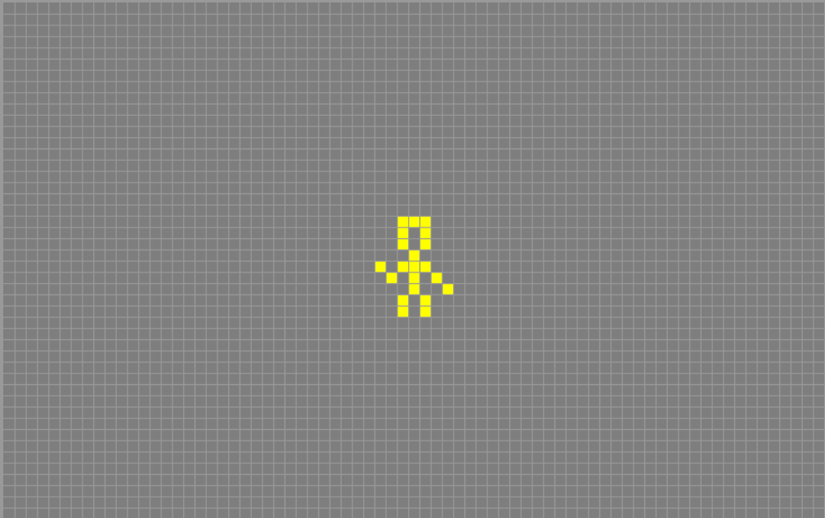
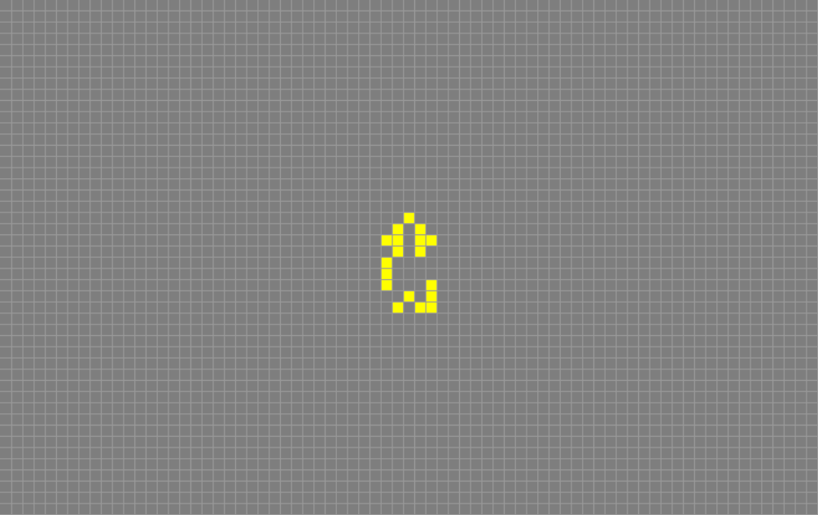
Game of Life
Transition rules:
- Any live cell with two or three live neighbors survives.
- Any dead cell with three live neighbors becomes a live cell.
- All other live cells die in the next generation. Similarly, all other dead cells stay dead.

Slide 8
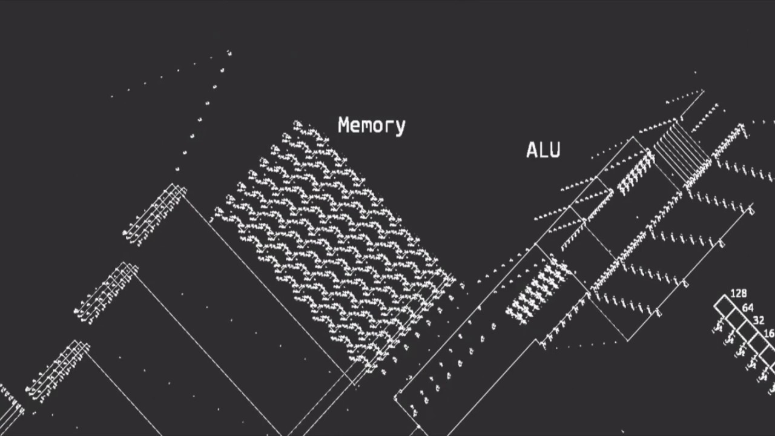
Game of Life
Interesting properties:
Turing complete
i.e. can simulate a Turing machine.
Undecidable
i.e. given two initial input patterns, there is no way to compute whether the one will result in another after an unspecified number of iterations (transitions). This is an implication of the Halting Problem.
Self-replicable
i.e. there exist self-constructing patterns that can replicate themselves while destroying the parent pattern.

Slide 9
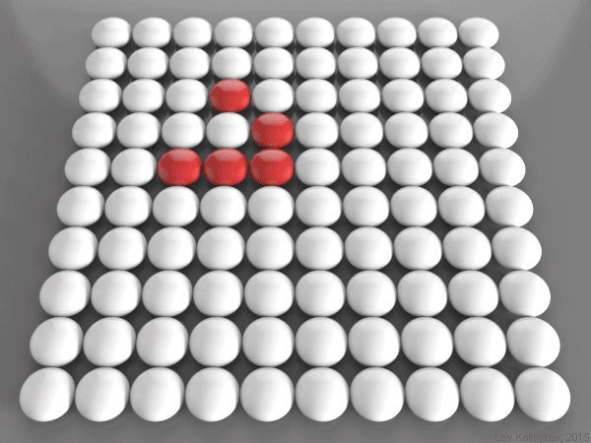
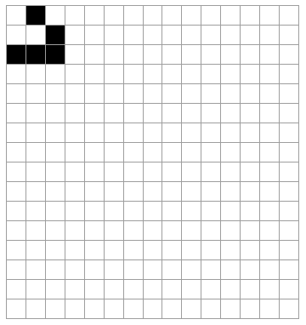
Game of Life Periodic Boundary Condition
Illustrations of the evolution of a Glider pattern
in a periodic (left) and non-periodic (right) version of Game of Life

Slide 10
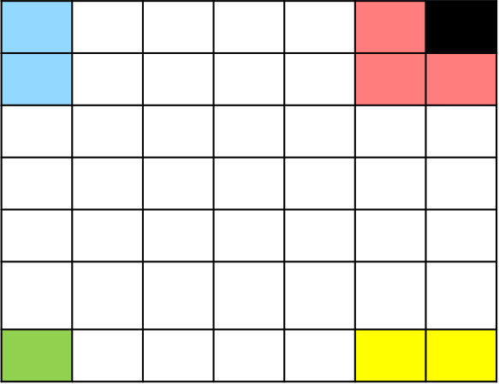
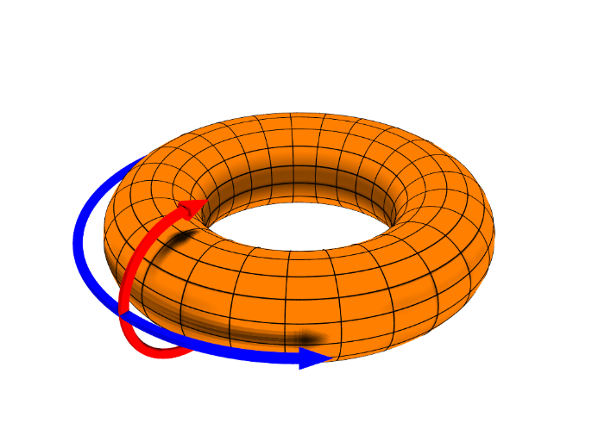
Game of Life Periodic Boundary Condition
A toroidal array visualization
The neighbors of a cell in a dish with a periodic boundary

Slide 11
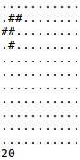
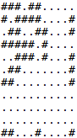
Game of Life Problem Description
Problem description:
Given an initial pattern (dish) and a positive integer n, compute the result of evolving the dish n times (that is the resultant dish after n transitions/evolutions) according to the rules of the periodic version of Conway’s Game of Life.
Input specification:
m lines containing m ‘#’ or ‘.’ characters are read from the input, where m is the length of the first line. The ‘#’ character specifies an alive cell, and the ‘.’ character indicates a dead cell, respectively. The last line of the input represents the positive integer n – the number of transitions that need to be performed on the initial dish.
Output specification:
The m×m dish that results from evolving the input dish n times.
Example input/output:

Slide 12
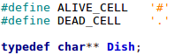
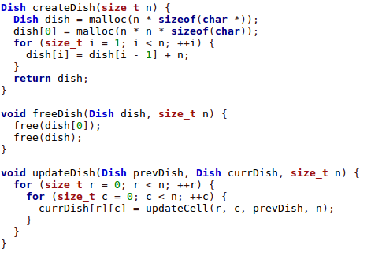
Sequential Game of Life Trivial Implementation

Slide 13
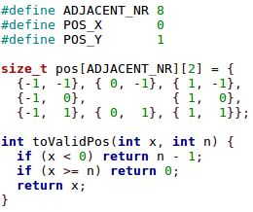
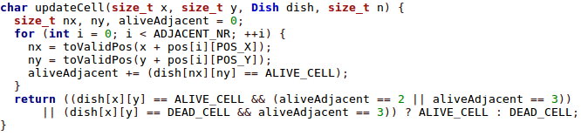
Sequential Game of Life Trivial Implementation
Implements the periodic boundaries
Count the number of alive neighbors
Apply the transition rules

Slide 14
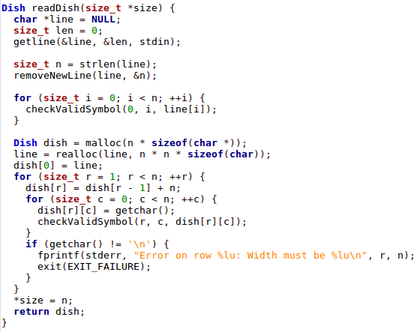
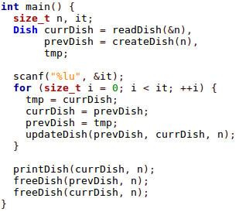
Sequential Game of Life Trivial Implementation

Slide 15
Intermezzo: 2D Arrays
The heap
… |  |  |  |  |  |  |  |  |  |  |  |  |  |  |  |  |  |  |  |  |  |  |  |  |  |  |  |  |  |  |  |  |  |  |  |  | …
Used region
Used region
void *a = malloc(…);
a+1
a+2
a+3
a
… |  |  |  |  |  |  |  |  |  |  |  |  |  |  |  |  |  |  |  |  |  |  |  |  |  |  |  |  |  |  |  |  |  |  |  |  | …
Newly allocated region
To access the content of a, we use *a, or a[0].
Note that a[i] is simply syntactic sugar for *(a+i).

Slide 16
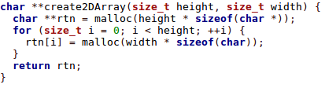
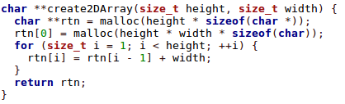
Intermezzo: 2D Arrays
Two ways to create a 2D array:
What is the difference?

Slide 17
Intermezzo: 2D Arrays
char **a = create2DArray(...);
a
a[0]
… |  |  |  |  |  |  |  |  |  |  |  |  |  |  |  |  |  |  |  |  |  |  |  |  |  |  |  |  |  |  |  |  |  |  |  |  |  |  |  | …
a[0][0]
a[0][1]
a[0][2]
a[0][3]
a[0][4]
a[2][0]
a[2][1]
a[1][0]
a[1][2]
a[2][2]
a[2][3]
a[2][4]
a[1][1]
a[1][3]
a[1][4]
a[2]
a[1]
The memory storing the data is not contigious

Slide 18
Intermezzo: 2D Arrays
char **a = create2DArray(...);
a[0]
a[2]
a
… |  |  |  |  |  |  |  |  |  |  |  |  |  |  |  |  |  |  |  |  |  |  | ... |  |  |  |  |  |  |  |  |  |  |  |  |  |  | …
a[2][1]
a[2][2]
a[0][0]
a[1][1]
a[2][3]
a[1][2]
a[1][3]
a[0][1]
a[2][0]
a[0][2]
a[0][3]
a[1][0]
a[3][1]
a[3][2]
a[3][0]
a[3][3]
a[1]
a[3]
The memory storing the data is contigious

Slide 19
Parallel Game of Life: Problem Analysis
Can not be parallelized. Every iteration depends on the computations done in the previous one
Not optimal to parallelize. The loop does only 8 iterations and the computations in each iteration are easy.

Slide 20
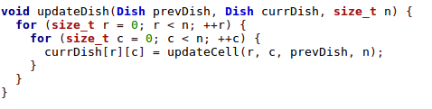
Parallel Game of Life: Problem Analysis
Good option. But how to?
Let us consider a subregion of the dish. To compute the state of the cells in red in the next iteration we need the current states of both red cells and orange cells:
 |  |  |  |  |  | ...
...
Notation:
Sub-dish – the cells in the red squares
Border – the cells in the orange squares
Idea:
assign each thread a sub-dish. Each thread can keep the state of the sub- dish but needs to fetch the states of the cells in the border from the threads that compute the adjacent sub-dishes. It also needs to send those threads the values of the margins of the sub-dish, as those will be their borders.

Slide 21
Parallel Game of Life: Problem Analysis
2 sub-dishes and their borders:
 |  |  |  |  |  |  | …
…
 |  |  |  |  |  |  | …
…
Downsides:
For a sub-dish of height and width n, we need to receive and communicate 4(n+1) values to the threads computing the adjacent regions in order to update the borders. 2n values are located on the columns and can not be communicated in a single send and receive request (as their memory regions will not be contiguous). Therefore we need 2*(2n + 2) request to send and receive the border values. Inter-process communication is slow! Can we do better?

Slide 22
Parallel Game of Life: Problem Analysis
…
Idea:
Assign each thread a sub-dish consisting of n rows, where n is the height of the dish divided by the number of threads. Now every sub-dish has only 2 borders, which are rows themselves and therefore can be send and received through a single query (since they are contiguous memory regions).

Slide 23
Parallel Game of Life: Problem Analysis
…
Idea:
Assign each thread a sub-dish consisting of n rows, where n is the height of the dish divided by the number of threads. Now every sub-dish has only 2 borders, which are rows themselves and therefore can be send and received through a single query (since they are contiguous memory regions).
Problem:
The height of the dish may not be divisible by the number of threads. How do we split the workload more fairly?
Example: Height is 160 and we have 15 threads.
160/15 ~ 10.
One solution: Give the first 14 threads 10 rows, and the last thread the rest. The last will get 160-14*10 = 20 rows, that is twice as much as the first 14 threads!
We can do better: 160%15 = 10. Give the first 10 threads one more row, and the rest 160/15 rows.
This will yield 11*10 + 5*10 = 110+50 = 160 rows. The first ten threads will have 11, and the last five – 10 rows.

Slide 24
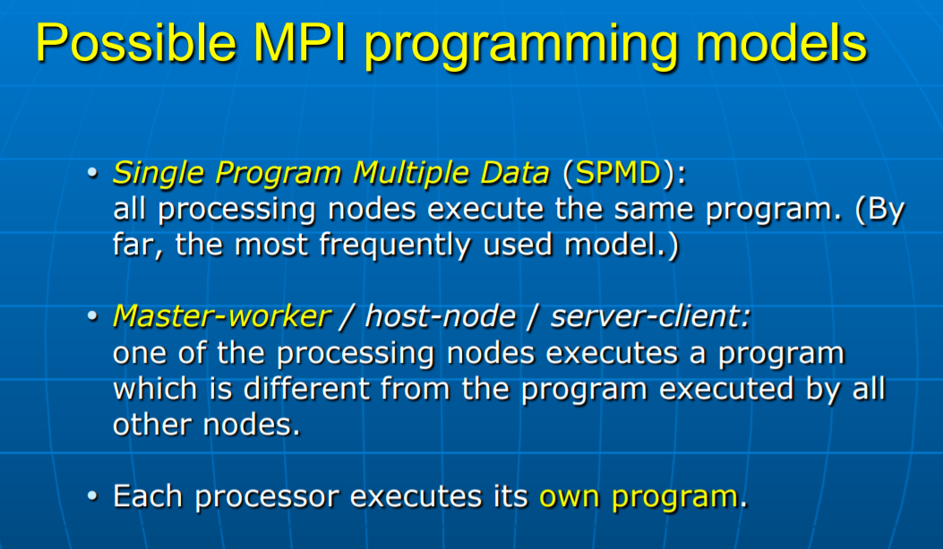
Parallel Game of Life: Model
We can split the dish into sub-dishes that have an approximately equal size. Since updating a cell takes the same amount of computations regardless of the properties of the cell or the dish, updating the sub-dishes should also take an approximately equal time. Therefore it is optimal to use the Single Program Multiple Data model.

Slide 25
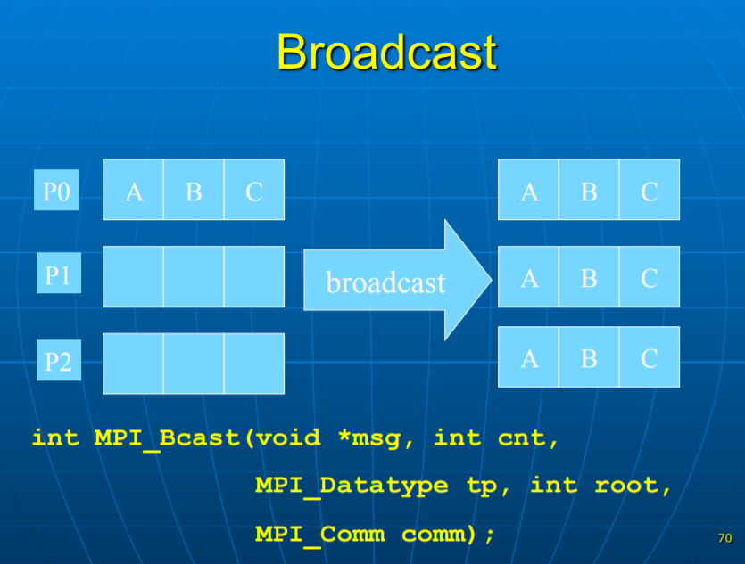
Parallel Game of Life: Implementation
All threads will execute the same program. They will also perform the same computations, except the root thread, which should also be responsible for input and output.
The input consists of the dish and the number of generations that need to be skipped. From the input we should also be able to infer the size of the dish. We wish to share the number of iterations, the size of the dish and the appropriate sub-dishes with the rest of the threads.
The number of iterations and the size of the dish is the same for all threads, so we can Broadcast.

Slide 26
Parallel Game of Life: Splitting the dish
…
Thread 1
Thread 2
Thread 3
Thread m

Slide 27
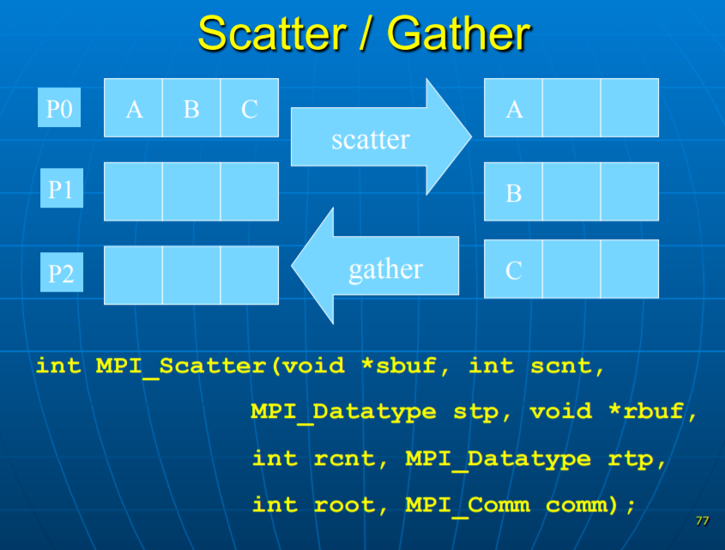
Parallel Game of Life: Splitting the dish
Thread 1
Thread 2
Thread 3
Thread m
 |  | … |  |  |  |  | … |  |  |  |  | … |  |  |  |  |  | … |  |  | …
Every thread should compute a different part of the dish. Since the dish is stored in a contiguous memory region, we can Scatter/Gather. But some threads may get an extra row, therefore we need to Scatterv/Gatherv.

Slide 28
Parallel Game of Life: Splitting the dish
…
int MPI_Scatterv(
void *sendbuf,
int *sendcnts,
int *displs, MPI_Datatype sendtype, void *recvbuf,
int recvcnt, MPI_Datatype recvtype, int root,
MPI_Comm comm
);

Slide 29
Parallel Game of Life: Splitting the dish
…
int MPI_Scatterv(
void *sendbuf,
int *sendcnts,
int *displs, MPI_Datatype sendtype, void *recvbuf,
int recvcnt, MPI_Datatype recvtype, int root,
MPI_Comm comm
);

Slide 30
Parallel Game of Life: Splitting the dish
…
int MPI_Scatterv(
void *sendbuf,
int *sendcnts,
int *displs, MPI_Datatype sendtype, void *recvbuf,
int recvcnt, MPI_Datatype recvtype, int root,
MPI_Comm comm
);

Slide 31
Parallel Game of Life: Splitting the dish
…
int MPI_Scatterv(
void *sendbuf,
int *sendcnts,
int *displs, MPI_Datatype sendtype, void *recvbuf,
int recvcnt, MPI_Datatype recvtype, int root,
MPI_Comm comm
);

Slide 32
Parallel Game of Life: Splitting the dish
int MPI_Scatterv(
void *sendbuf,
int *sendcnts,
int *displs, MPI_Datatype sendtype, void *recvbuf,
int recvcnt, MPI_Datatype recvtype, int root,
MPI_Comm comm
);
Thread k

Slide 33
Parallel Game of Life: Updating the borders
…
MPI_Recv(
void* data,
int count,
MPI_Datatype datatype,
int source,
int tag,
MPI_Comm communicator,
MPI_Status* status
);
Thread k-1
…
Thread k
MPI_Send(
void* data,
int count,
MPI_Datatype datatype,
int destination,
int tag,
MPI_Comm communicator
);
…
Thread k+1

Slide 34
Parallel Game of Life: Updating the borders
…
Thread k-1
int MPI_Sendrecv(
const void *sendbuf,
int sendcount,
MPI_Datatype sendtype,
int dest,
int sendtag,
void *recvbuf,
int recvcount, MPI_Datatype recvtype,
int source,
int recvtag,
MPI_Comm comm,
MPI_Status *status
);
…
Thread k
…
Thread k+1

Slide 35
Parallel Game of Life: Updating the borders
Every thread must exchange 2 borders.
So every thread must make 2 MPI_Sendrecv calls for the upper and lower borders.
Note that the upper row of a sub-dish is not the upper border of the previously adjacent thread, but the lower.
Since MPI_Sendrecv blocks it is important to always send and receive one end. Otherwise we reach a deadlock!
That will happen when we send the lower row and always wait for the lower border. Since all threads will send their lower rows first, the MPI_Sendrecv will block on the receive part, as no thread will get to the second statement, which will send their upper border, needed to unlock the first.
Upper border
…
Upper row
Thread 1
Lower row
Lower border
…
Upper border
…
Upper row
Thread m
Lower row
Lower border

Slide 36

Let’s Code!

